Slide 1
Support of Scholarly Activities (SOSA)
Fall 2019 SOSA Workshop:
Wednesday, September 18, 2019

Slide 2
What is SOSA?
SOSA = Support of Scholarly Activities
Mechanism to afford release time within workload (equivalent to 3 FWH) or funding ($5,235) for each year for activities that are beyond the level already expected and included within normal workload.
All tenure track or tenured faculty and librarians are eligible to receive SOSA awards, except for those in their first 3 years of employment who are ineligible for SOSA (NFSS announcement 9/9/19). This only affects applicants who started at TCNJ in the fall of 2019 or later.
Duration: most are 2-year, and some 1-year
Support of ongoing and new activities
Preliminary data or accomplishments are not required.

Slide 3
What Does it Support?
Support of scholarly, creative, or professional activities:
Scholarship that is consistent with the scholarly activities defined in the TCNJ Promotion and Reappointment Document is eligible for support.
examples: performing experiments, analyzing data, developing a new theorem or argument, editing a book, developing an art show or catalog, preparing for a musical recital, annotating a musical score, researching and writing an article, book chapter, or book

Slide 4
IMPORTANT
All parts of the application must be submitted in Vibe and in PDF format.

Slide 5
SOSA Application
Parts to the application:
Cover form
Proposal Narrative (3 single-spaced pages maximum)
Annotated CV
SOSA Final Reports (if needed; past 5 years only)
Budget (if needed), maximum 1 page (to be evaluated by the Office of Academic Affairs)
Chair and Dean signatures are required later (not collected by submitter)
IRB approval is not required for SOSA submission, but applicants must make appropriate actions to have IRB approval in place prior to start of SOSA project.

Slide 6
SOSA Application
Proposal types – individual or collaborative
Collaborative proposals require that each collaborator seeking SOSA funding submit an individual proposal. The role of each collaborator must be clearly defined.
Electronic Submission through Vibe
Initial submission (cover page and document uploads), intermediate steps (modifications, chair/dean acknowledgments), and final submission
Once final submission occurs, no further changes can be made.

Slide 7
SOSA Application: Proposal Narrative
Concise description of the proposed scholarly activity (“elevator talk” with overall goal, context and purpose). Remember who is reading and assessing your submission. Citations not needed.
Proposed objectives of the scholarly activities (specific activities/subprojects to be performed during the award period)
Detailed plan of scholarly activity with proposed timeline (how you will conduct the activities/subprojects during the funding period)
Expected scholarly outcomes (tangible results/products and broader impact)
Notes:
Food for thought: Is there a way to clarify the difference between Objectives and Outcomes? That part of the application has always been confusing to people. My objective is to write a book, my outcome is to write a book. Or is it my objective is to understand the Laffer Curve in a post-industrial economy and my outcome is a book. (And why do I need to say a lot about my outcome: an article, a book, an art installation.)

Slide 8
SOSA Application: Proposal Narrative
Assume your audience is not an expert in your field, avoid highly specialized terms (without definition)
Consult RFP and sample proposals available on the SOSA website; although those may not reflect this year’s rubric
No more than 3 single-spaced pages, 1-inch margins, Times New Roman font, 12 pt. font

Slide 9
IMPORTANT
Applicants are asked to include a brief paragraph or table at the end of their annotated CV that summarizes, if applicable, their Final SOSA reports from the past five years and describes their progress on SOSA-sponsored research.

Slide 10
ALSO IMPORTANT
Applicants who have received SOSA award(s) within the past five (5) years must include copies of completed awards.
Applications that lack final reports will not be reviewed.
Final reports should also be submitted to the Office of Academic Affairs on or before the first Monday in October.

Slide 11
Budget
Applicants requesting monetary award should include a proposed budget and its justification on a separate file through Vibe (one page or less).
Funds may not be used for applicant’s salary.

Slide 12
SOSA Application: Budget
Examples of what may be covered:
travel to research sites
equipment supplies and technology purchases, purchases of datasets
payment of a participation fee to participants in experiments
travel to present research results

Slide 13
SOSA Application: Budget
Office of Academic Grants and Sponsored Research (OAGSR) will review adherence to budget
Appropriate deans will approve
SOSA Committee does not make decisions regarding budget
Applicants must determine which year or years budget will be used
Must use funds during that academic year only

Slide 14
SOSA Application Evaluation
Grading Rubric/Assessment
the project itself / proposal narrative (35 points)
qualifications of the applicant / CV (15 points)
Pre-tenure (2 points)
Maximum score of 52 points

Slide 15
Checklist
Proposal Narrative Yes No | Annotated CV Yes No | Final reports (if needed) Yes No | Budget (if needed) Yes No
NOTE: final reports only include the prior 5 years
Budgets: no more than 1 page on separate PDF

Slide 16
Caution!!!
Your proposal will not be evaluated if it does not have the proper format or is missing documents (e.g. missing a final SOSA report)
Refer to checklist (proposal narrative, annotated CV, budget if needed, final reports if needed)
Submissions after deadline will NOT be reviewed (due October 1st, 2019 at 11:59pm)
Submissions that are a continuation of previously sponsored SOSA awards must specify how the current proposal differs
Notes:
Clarify last bullet point: Detail work that has been completed, progress made, obstacles encountered, new directions identified, and proposed next steps.

Slide 17
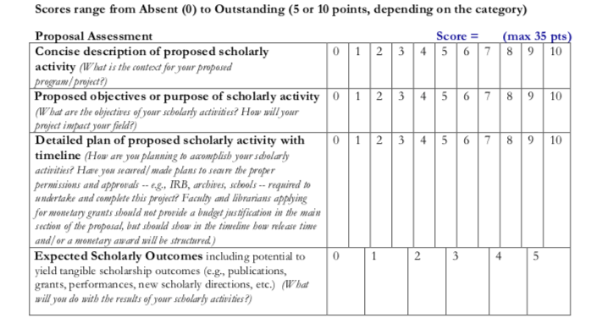
Proposal Assessment Rubric
Notes:
Food for thought: It might also be useful to convey what makes a good description -- what makes one description strong and another just good?

Slide 18
SOSA Application: Qualifications and Scholarly Record
Will be reviewed based upon evidence submitted in the annotated CV and prior SOSA reports (required only for SOSA awards completed within the past five years)

Slide 19
SOSA Application: Pre-Tenure
Must specify on the cover form

Slide 20
SOSA Application: CV
CV must be annotated
Explain contributions to scholarship (e.g. multi-author papers).
Consider providing a 1-2 sentence summary of the work (or service).
Provide evidence of the scope and importance of scholarship (e.g., citations, newspaper write up, professional critique/award, was the work of national or international score?).
Although too much annotation detracts, it is important to help readers outside the applicant’s field assess the scope and quality of the applicant’s record of scholarship.
CV can be in any format, but remember who is reading

Slide 21
Committee Members 2019-2020
10 members representing all schools and Library
Bozena Leven (Provost Designee)
Notes:
note that the Interim Vice Provost on the committee does not rate applications and does not vote.

Slide 22
SOSA Additional Information
Application deadline: October 1, 2019 by 11:59 pm EST.
RFP, supplemental information and sample proposals available on Academic Affairs website:
http://academicaffairs.tcnj.edu/faculty/research-faculty-development/

Slide 23
Questions?

