Slide 1
Support of Scholarly Activities (SOSA)
Fall 2018 SOSA Workshop:
Wednesday, September 12, 2018

Slide 2
What is SOSA?
SOSA = Support of Scholarly Activities
Mechanism to afford release time within workload (equivalent to 3 FWH) or funding ($5,235) for each year for activities that are beyond the level already expected and included within normal workload.
All tenure track or tenured faculty and librarians are eligible to receive SOSA awards.
Duration: most are 2-year, and some 1-year
Support of ongoing and new activities
Preliminary data or accomplishments are not required.

Slide 3
What Does it Support?
Support of scholarly, creative, or professional activities:
Scholarship that is consistent with the scholarly activities defined in the TCNJ Promotion and Reappointment Document is eligible for support.
examples: performing experiments, analyzing data, developing a new theorem or argument, editing a book, developing an art show or catalog, preparing for a musical recital, annotating a musical score, researching and writing an article, book chapter, or book

Slide 4
SOSA Application
Parts to the application:
Cover form
Proposal narrative
Annotated CV
SOSA Final Reports (if needed; past 5 years only)
Budget (if needed), maximum 1 page
Chair and Dean signatures are required later (not collected by submitter)
IRB approval is not required for SOSA submission, but applicants must make appropriate actions to have IRB approval in place prior to start of SOSA project.

Slide 5
SOSA Application
Proposal types – individual or collaborative
Collaborative proposals require that each collaborator seeking SOSA funding submit an individual proposal. The role of each collaborator must be clearly defined.
Electronic Submission through Vibe
Initial submission (cover page and document uploads), intermediate steps (modifications, chair/dean acknowledgments), and final submission
Once final submission occurs, no further changes can be made.

Slide 6
Committee Members 2017-2018
10 members representing all schools and Library
David Blake (Interim Vice Provost, Academic Affairs)

Slide 7
SOSA Application Evaluation
Grading Rubric/Assessment
the project itself / proposal narrative (25 points)
qualifications of the applicant / CV (5 points)
non-tenured or reengaging faculty (Yes/No: 0-1 point)
Maximum score of 31 points

Slide 8
Checklist
Proposal Narrative Yes No | Annotated CV Yes No | Final reports (if needed) Yes No | Budget (if needed) Yes No
NOTE: final reports only include the prior 5 years
Budgets: no more than 1 page on separate PDF

Slide 9
Caution!!!
Your proposal will not be evaluated if it does not have the proper format or is missing documents (e.g. missing a final SOSA report)
Refer to checklist (proposal narrative, annotated CV, budget if needed, final reports if needed)
Submissions after deadline will NOT be reviewed (due October 1st, 2018 at 11:59pm)
Submissions that are a continuation of previously sponsored SOSA awards must specify how the current proposal differs
Detail on work completed, progress made, obstacles encountered, new directions identified, & proposed next steps.

Slide 10
SOSA Application: Cover Form
Fill out on Vibe
Separate Cover Sheet not needed

Slide 11
SOSA Application: Proposal Narrative
Concise description of the proposed scholarly activity (“elevator talk” with overall goal, context and purpose). Remember who is reading and assessing your submission. Citations not needed.
Proposed objectives of the scholarly activities (specific activities/subprojects to be performed during the award period)
Detailed plan of scholarly activity with proposed timeline (how you will conduct the activities/subprojects during the funding period)
Expected scholarly outcomes (tangible results/products and broader impact)
Importance and Significance to one’s discipline and audience

Slide 12
SOSA Application: Proposal Narrative
Assume your audience is not an expert in your field, avoid highly specialized terms (without definition)
Consult RFP and sample proposals
No more than 3 single-spaced pages, 1-inch margins, Times New Roman font, 12 pt. font

Slide 13
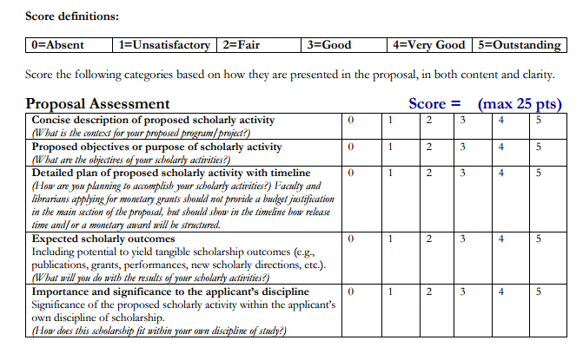
Proposal Assessment Rubric

Slide 14
SOSA Application: Qualifications and Scholarly Record
Will be reviewed based upon evidence submitted in the annotated CV and prior SOSA reports (required only for SOSA awards completed within the past five years)

Slide 15
SOSA Application: Pre-Tenure or Re-engaging Status
Must specify on the cover form
Must describe concisely on the cover form how re-engaging status is applicable

Slide 16
SOSA Application: CV
CV must be annotated
Explain contributions to scholarship (e.g. multi-author papers).
Consider providing a 1-2 sentence summary of the work (or service).
Provide evidence of the scope and importance of scholarship (e.g., citations, newspaper write up, professional critique/award, was the work of national or international scope?).
Highlight (as deemed appropriate) activities and responsibilities that demonstrate reengagement.
Although too much annotation detracts, it is important to help readers outside the applicant’s field assess the scope and quality of the applicant’s record of scholarship.
CV can be in any format, but remember who is reading

Slide 17
SOSA Application: Budget
Examples of what may be covered:
travel to research sites
equipment supplies and technology purchases, purchases of datasets
payment of a participation fee to participants in experiments
travel to present research results

Slide 18
SOSA Application: Budget
Office of Academic Grants and Sponsored Research (OAGSR) will review adherence to budget
Appropriate deans will approve
SOSA Committee does not make decisions regarding budget
Applicants must determine which year or years budget will be used
Must spend funds by the end of the fiscal year

Slide 19
SOSA Additional Information
Since Vibe does not work well with Internet Explorer, (submissions from Internet Explorer may give error messages), we recommend using Google Chrome or Firefox instead
Files should be uploaded individually
Note that dragging and dropping your files may not work in Vibe

Slide 20
SOSA Additional Information
Application deadline: October 1, 2018
RFP, supplemental information and sample proposals available on Academic Affairs website:
http://academicaffairs.tcnj.edu/faculty/research-faculty-development/

Slide 21
Questions?

