Slide 1
Submitting and reviewing promotion applications in Vibe 2018-2019

Slide 2
Initial points
Use of electronic means for submitting promotion applications is regulated by MOA#103. MOA#106 allowed candidates to retain read-only access to their application after it is submitted
Vibe houses the materials of Standard Application, supporting documentation, final recommendations and applicant’s responses to recommendations
Some supporting documentation can be submitted either in Vibe or in hard copy (eg, books)

Slide 3
Tips
Vibe does not function like Google Drive. You cannot store documents in Vibe and access them later. You cannot reuse these materials for other Vibe applications (eg, SOSA)
Make sure you retain copies of all your documents.

Slide 4
STAGE I: Application submission
Academic Affairs will populate Vibe with the list of promotion applicants. Only this group will have permission to create entries with their applications
Each applicant will receive an email (sent BCC) with the link to the promotion application’s cover page

Slide 5
Applicant sees the following when they use the link given by Academic Affairs via email:

Slide 6
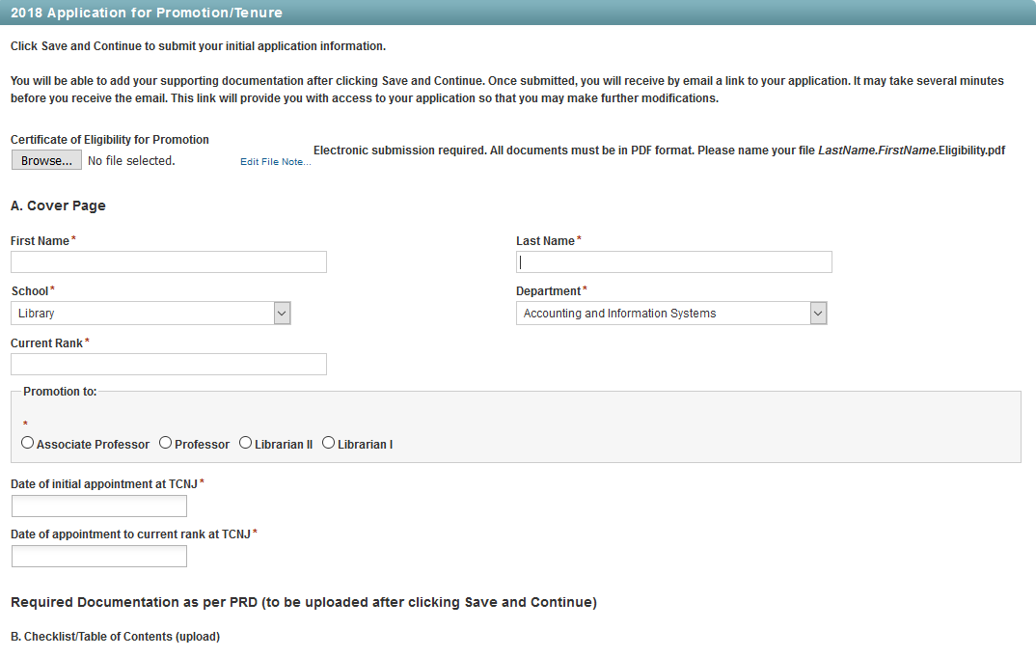
Applicant fills out the cover page and clicks “Save and Continue.” Note: Applicants no longer need to upload the HR Certificate of Eligibility

Slide 7
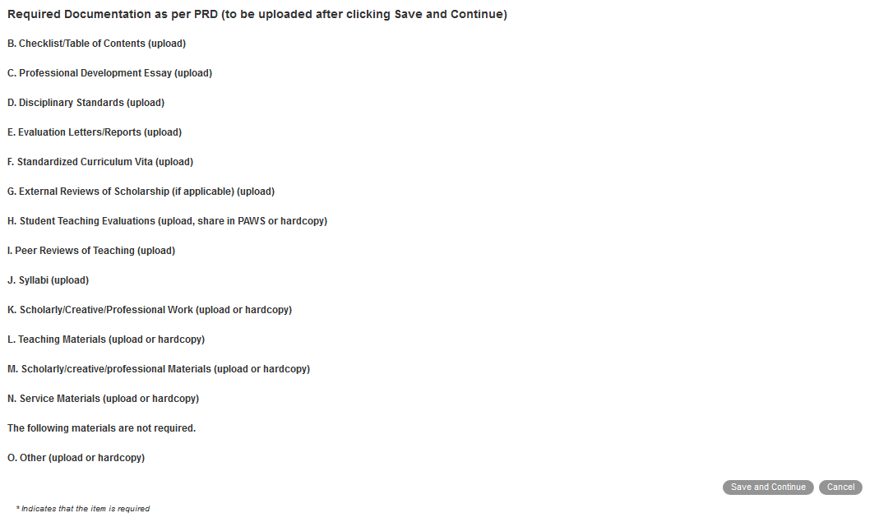
Bottom of the page:

Slide 8
After clicking “Save and Continue,” applicants log out of Vibe and open their email. Vibe will have sent a message with a “gateway link” to the newly created application. This link is used for any continuing modifications or file uploads.

Slide 9
Requirements for Teaching Evaluations
“For promotion applications, include evaluations and reports for every course taught in the three (3) to five (5) years prior to the application. Candidates who are eligible to apply for reappointment or promotion within three years of initial appointment should submit required documentation (e.g., student evaluations, peer reviews) for all years of employment at the College.” pg. 68

Slide 10
Options for Sharing Teaching Evaluations
In PAWS, click on Course Feedback Results, Manage My Shares, and then select PRC members, Dean, Provost, President, and CPTC members. This will provide access to all the collected evaluations. Reviewers are instructed to look at only the past 3-5 years.
If you actively want to limit the evaluations to the past 3–5 years, you should print the evaluations and combine them into pdf files that you can upload. (You can also Save As a pdf.)

Slide 11
More Information
All student evaluations from Fall, 2014 and later are stored in PAWS.
1) To share access to all of your student feedback through PAWS, click on Course Feedback Results, Manage My Shares (For more details, see https://recreg.tcnj.edu/files/2014/11/Sharing-Course-Feedback-With-Committee-Members.pdf )
OR
2) You can print and combine the PDFs into a single file. (For more instructions, see https://recreg.tcnj.edu/files/2014/11/How-to-Print-to-PDF-your-Course-Feedback-Individual-Student-Responses-and-Class-Summary.pdf.)

Slide 12
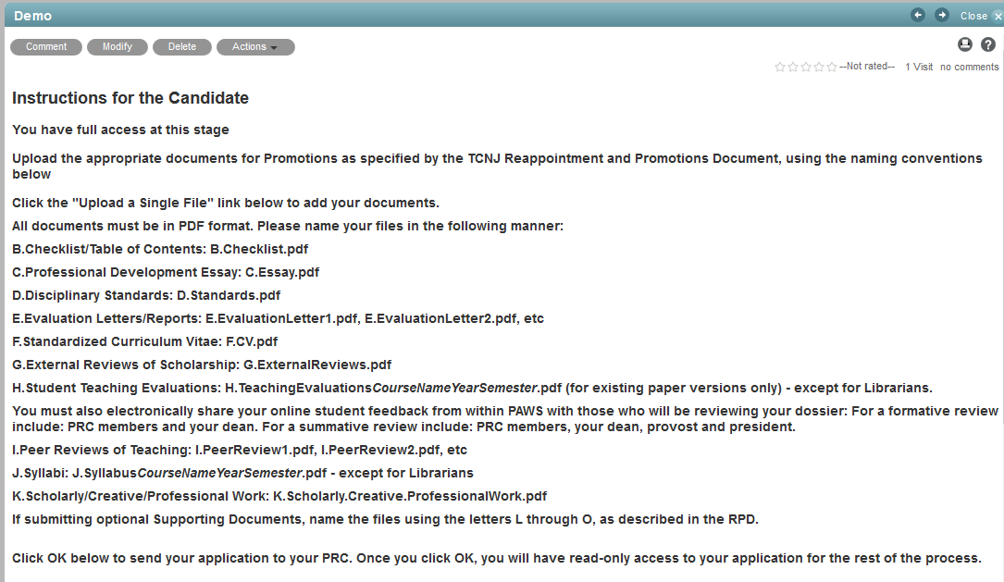
Top of the page with instructions: Applicants follow the link in the email and log into Vibe. Applicants can now start uploading their documents, following instructions. Note that the document names come after the colons below. The instructions in Vibe are now clearer.

Slide 13
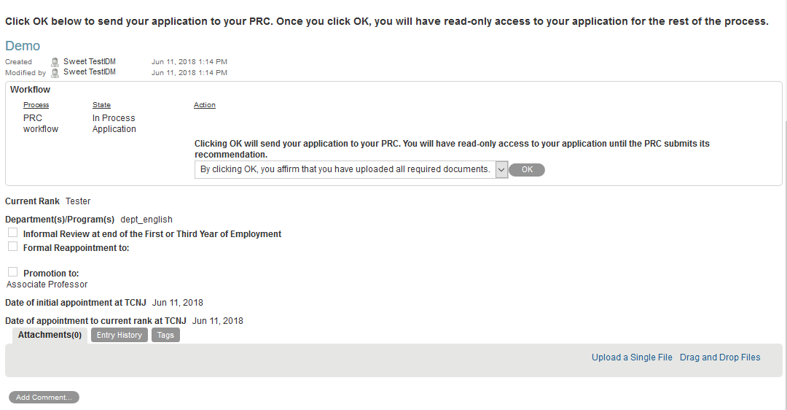
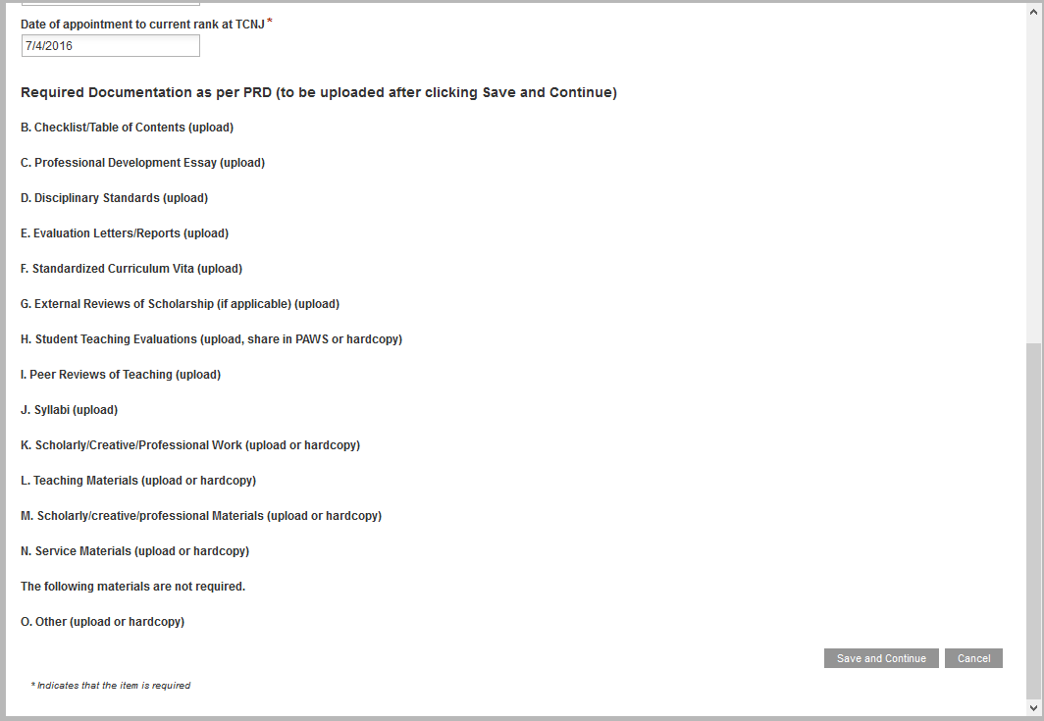
After all documents have been uploaded, the applicant clicks on OK in the middle of the page. **Do not click OK until you are completely done and ready to submit.**

Slide 14
Two Concerns
Vibe does not work well with Internet Explorer. You may get an error message if you submit from IE.
Files have to be uploaded individually. Drag and Drop does not work with Vibe.

Slide 15
STAGE II: Departmental PRC’s review
Once applicants click “OK” affirming that their application is complete, members of departmental PRC will receive an email notification with the link that will take them to the application in Vibe.
Applicants will also receive an email.

Slide 16
PRC members receive the following email:
Applicant receives the following email:

Slide 17
The application will now remain in the departmental PRC folder while the Committee considers the application
At this stage, only members of departmental PRC have modification rights to the folder with applications. Applicants have read-only access and cannot modify their application during this stage.
Departmental PRC will send their initial recommendation to the applicant by hard copy or email attachment not using Vibe
Members of PRC and the applicant will sign the recommendation
Then the Chair of departmental PRC will print, initial and upload the Checklist; upload the final recommendation and answer the question “Send final recommendation to the candidate” as “OK” in Vibe.

Slide 18
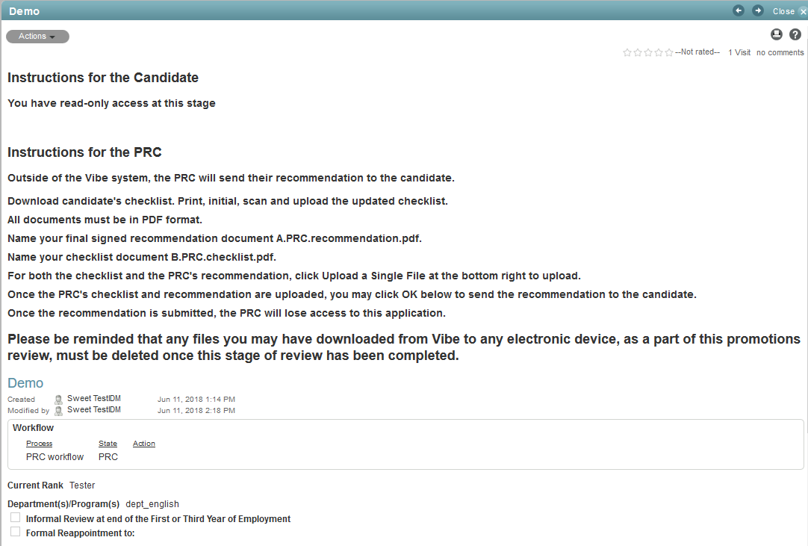
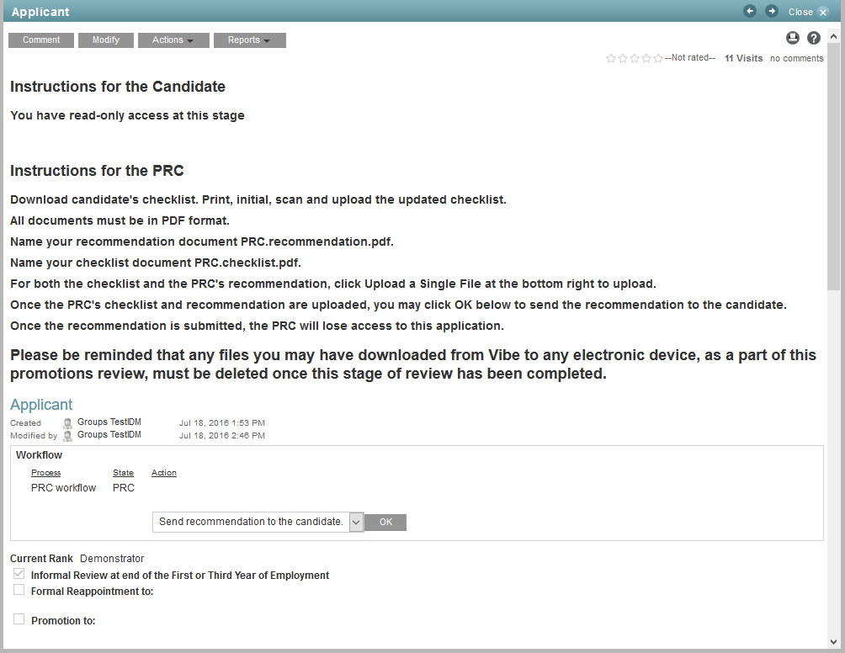
Follow instructions on the top of the page: When a member of the Departmental PRC follows the link in the email, they will see the applicant’s entry. Note: the PRC should put an A. before their file name.

Slide 19
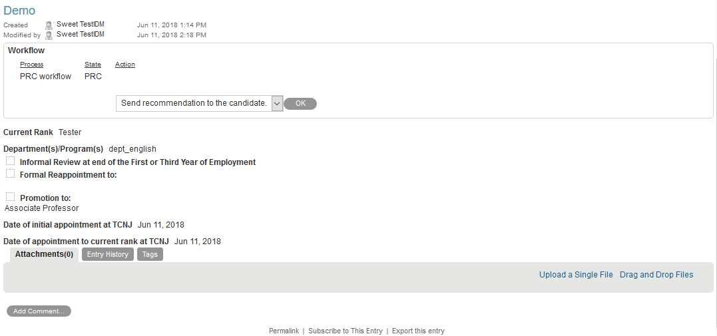
Bottom of the page: Please remember, only the chair of the PRC should click OK to submit recommendation:

Slide 20
After the Chair of the departmental PRC has uploaded the recommendation and the checklist and then and clicked “OK,” all members of PRC will see “Access denied” when clicking the link.

Slide 21
Applicants will receive an email with a link to their applications. The rights to modify the application have been restored allowing applicants to upload their response to PRC’s final recommendation. **Please remember: Applicants are responsible for moving their applications forward in the Promotions process. If you don’t choose OK to proceed, your application will not be considered.**

Slide 22
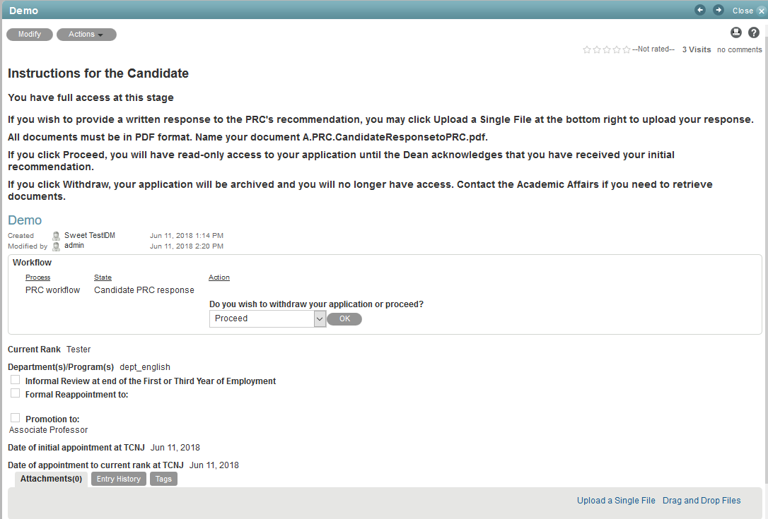
Applicant follows instructions at the top of the page. PRC’s recommendation is in the list of documents at the bottom of the page. Having uploaded their response, applicants choose Proceed or Withdraw. In case of withdrawal, their entry will be removed from the workflow and archived. If they choose to “Proceed”, the application will go to the Dean.

Slide 23
STAGE III: Dean’s review

Slide 24
Dean of the School receives the following email:
Applicant receives the following email:

Slide 25
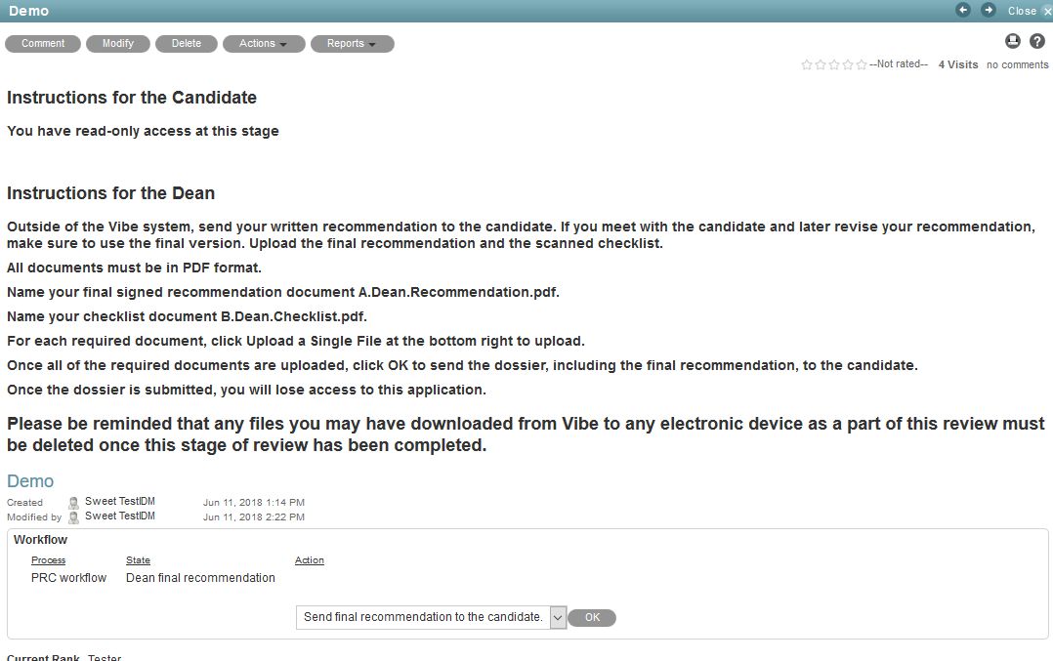
Dean follows the link in the email. Instructions are at the top. Applicant’s documents and PRC’s recommendation are at the bottom of the page.

Slide 26
Deans will send their initial recommendations to applicants in a hard copy or email attachment not using Vibe
If requested by the applicant, Dean will meet with the applicant
After the meeting, Deans will print, initial and upload the Checklist; upload their final recommendation and answer the question “Send final recommendation to the candidate” as “OK” in Vibe

Slide 27
After Deans click OK to send their final recommendation to the applicant, they see “Access denied.”

Slide 28
After Deans have uploaded their final recommendations and clicked OK to send back to the applicant, applicants receive an email giving modification rights to the application. Applicants can then click the link to review Dean’s final recommendation.

Slide 29
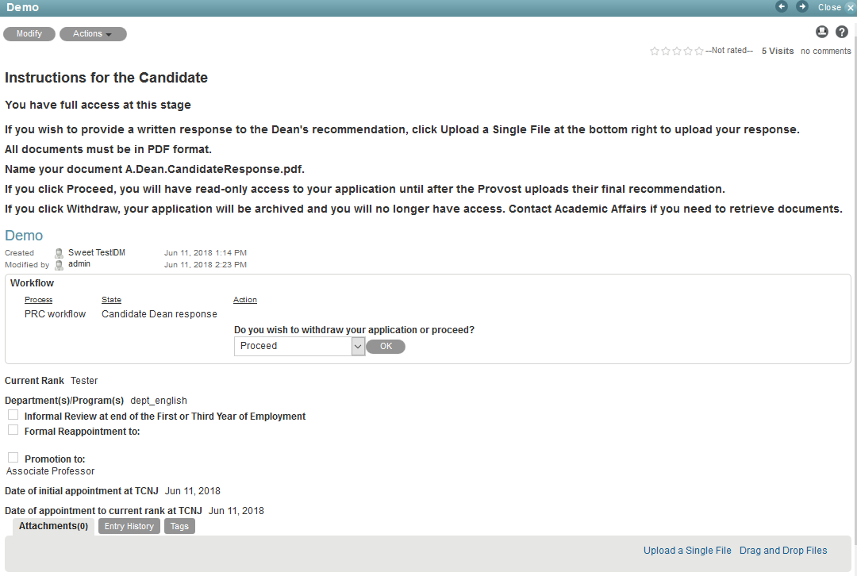
After reviewing the Dean’s final recommendation, the applicant may upload a response. The applicant has to choose Proceed or Withdraw. Withdrawing will remove the application from the process. Proceeding will send the application to the CPTC.

Slide 30
STAGE IV: CPTC’s review
Once the candidate clicks “Proceed”, the application will be moved to the CPTC’s folder
Members of CPTC will receive an email notification with the link to application
Only members of the CPTC will have access to the CPTC folder
As before, the applicant has read-only access to the application

Slide 31
The members of the CPTC receive the following email (incorrectly noted as CPC on Vibe):
Applicant receives the following email:

Slide 32
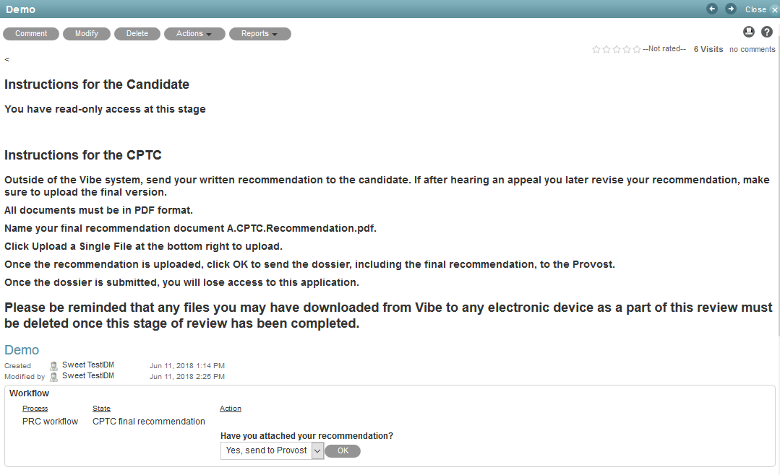
CPTC members follow the link to see the application. Please note and follow instructions at the top of the page. After the completion of review, the Chair of CPTC uploads the recommendation and clicks “OK” to send the application on to the Provost. Reminder: the chair of CPTC should put A. before the recommendation name.

Slide 33
Note
Unlike the previous and subsequent stages, any appeal of the CPTC’s decision will take place during a hearing rather than through the uploading of a written response.

Slide 34
STAGE VI: Provost’s review
Once CPTC’s recommendation has been uploaded, the Provost will receive an email notification

Slide 35
Provost receives the following email:
Applicant receives the following email: Remember to follow link and move the application forward.

Slide 36
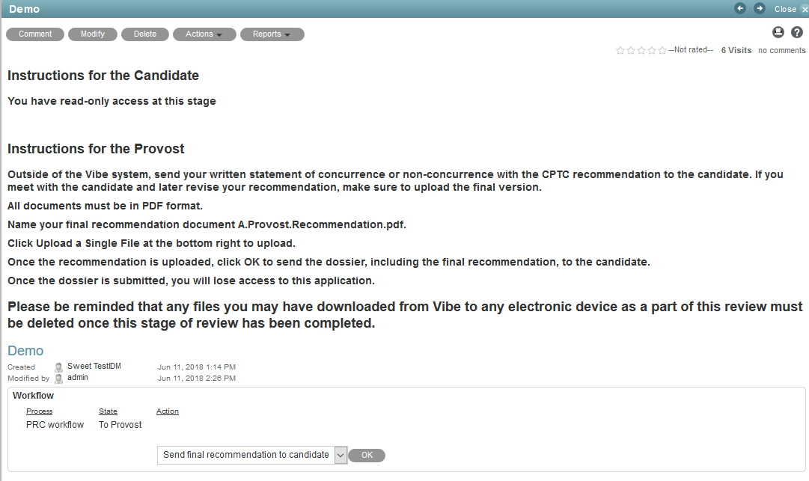
Provost follows the link to see the application. Instructions are at the top and documents at the bottom of the page. Provost uploads the recommendation and clicks “OK” to send the entry back to the applicant for a response.

Slide 37
Applicants receive an email giving them modification rights to their applications. Applicants then click the link to review Provost’s final recommendation.

Slide 38
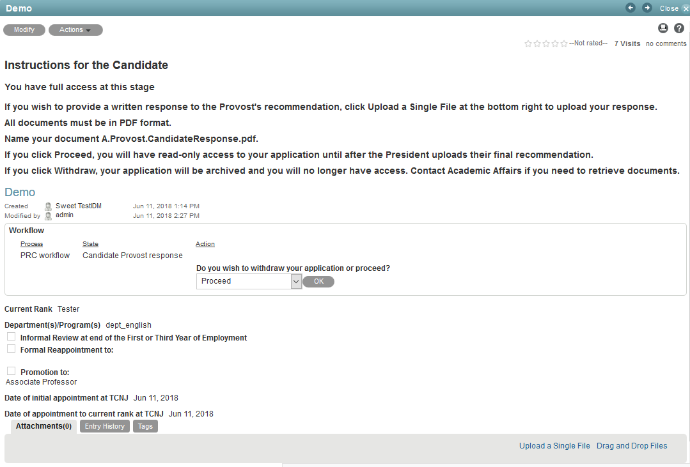
After applicants have reviewed Provost’s recommendation, they decide to Proceed or Withdraw. Withdrawing does the same as before. Proceeding sends the application to President. Remember: you need to click OK to send the application to the President. Appeals are in writing and uploaded.

Slide 39
STAGE V: President’s review
If the applicant chooses to proceed, an email notification is sent to President

Slide 40
President receives the following email:
Applicant receives the following email:

Slide 41
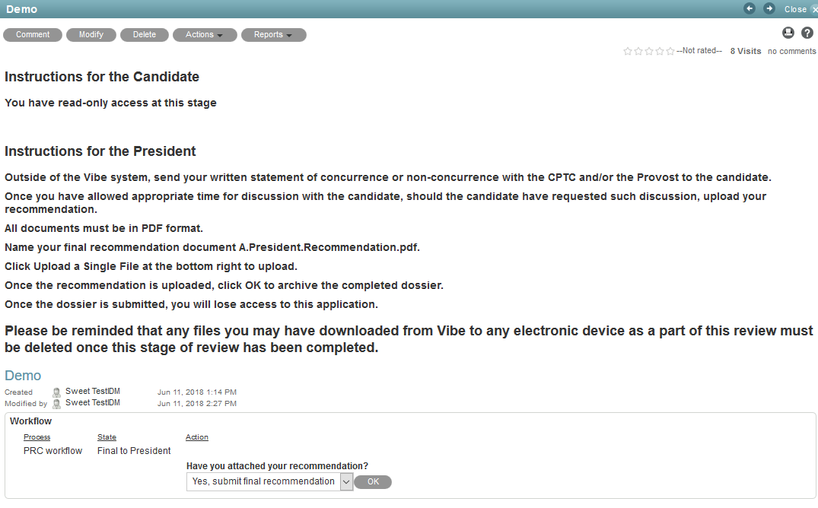
President reviews all documents previously submitted, uploads the final recommendation and clicks “OK” following the instructions. There are no appeals at this level.

Slide 42
After President clicks OK, applicant receives the following email:

Slide 43
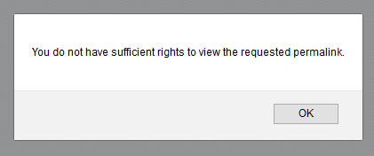
Once President has clicked “OK” to submit the final recommendation, the application is moved to a “Completed” folder. No one except the Vibe administrator in IT has access to the application. Applications are stored and archived on TCNJ servers. They still exist and, in exceptional cases, can be retrieved by making a request to Academic Affairs.
If applicants were to attempt to access their application after the workflow has completed, they will see the following message. Vibe has no accessible memory for applicants who choose to reapply after being denied. Candidates should download and save their materials at the beginning if they want to use some of them in subsequent years.

